Slide 1
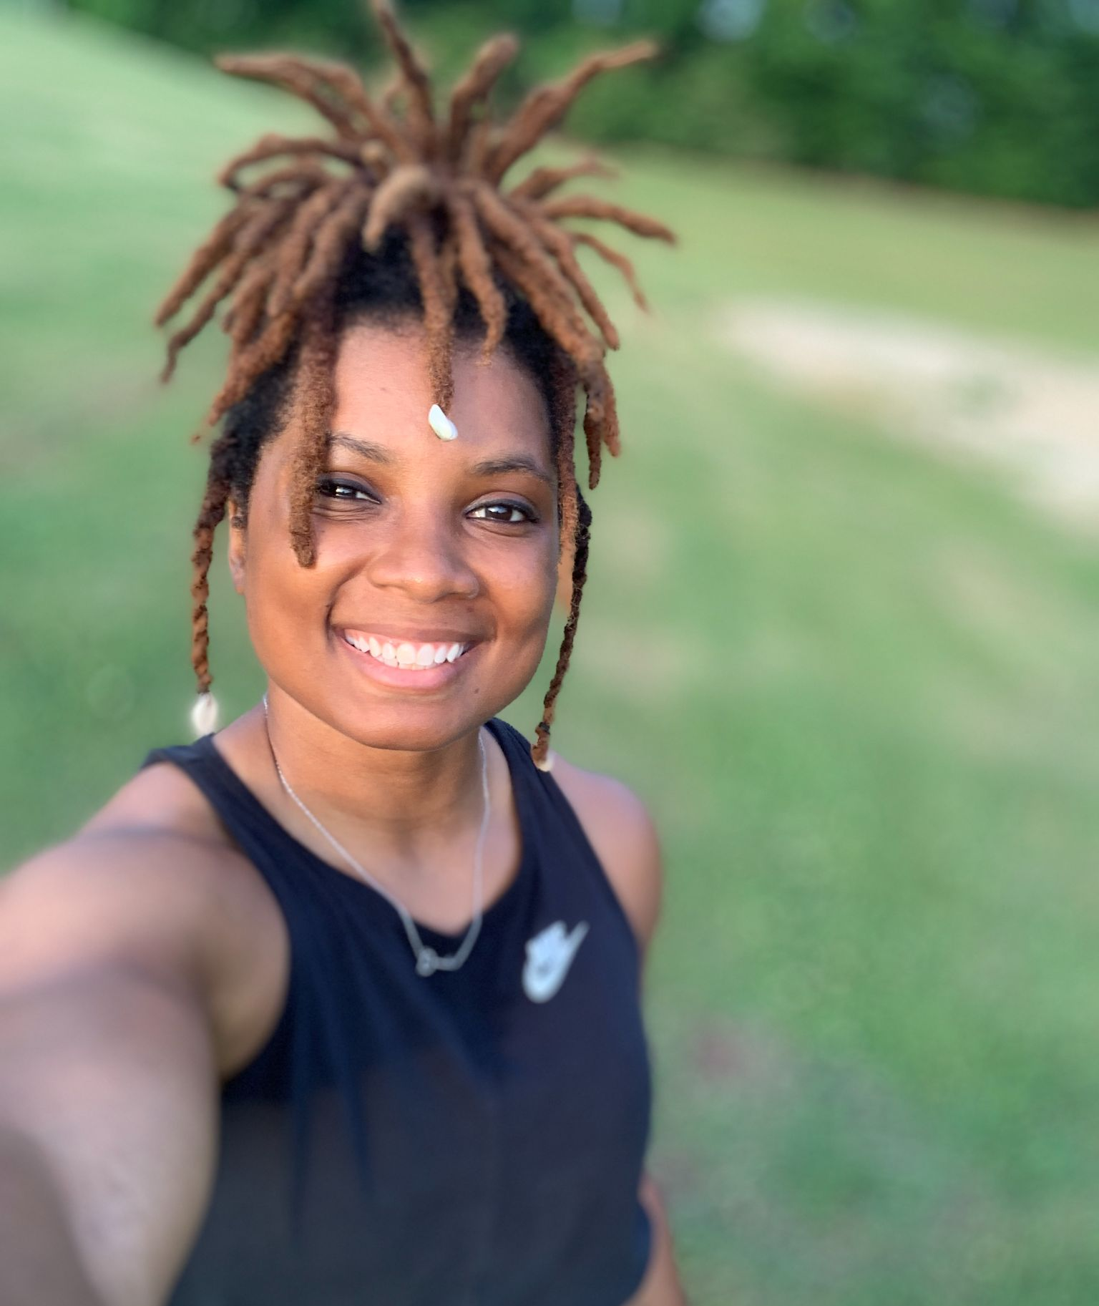
Coach Powers
LIFE PE
Girl’s Basketball

Slide 2
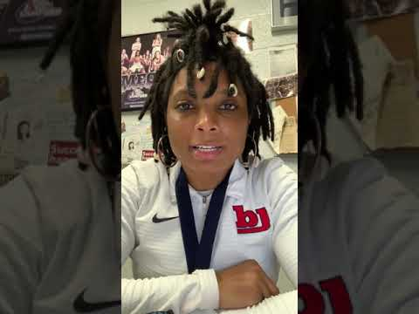
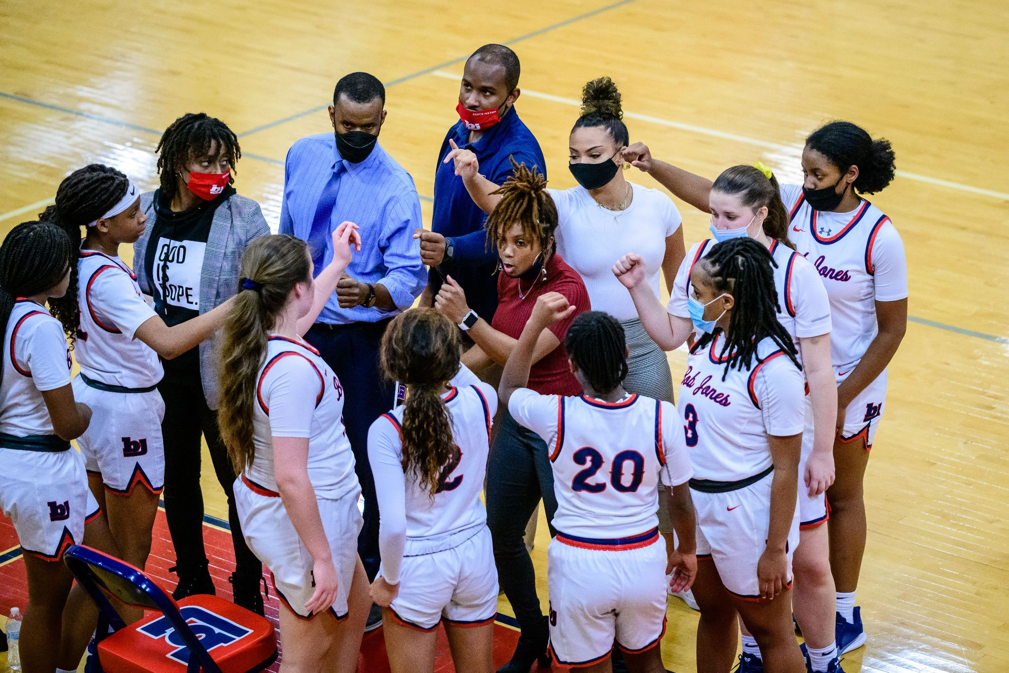
About Me Video

Slide 3
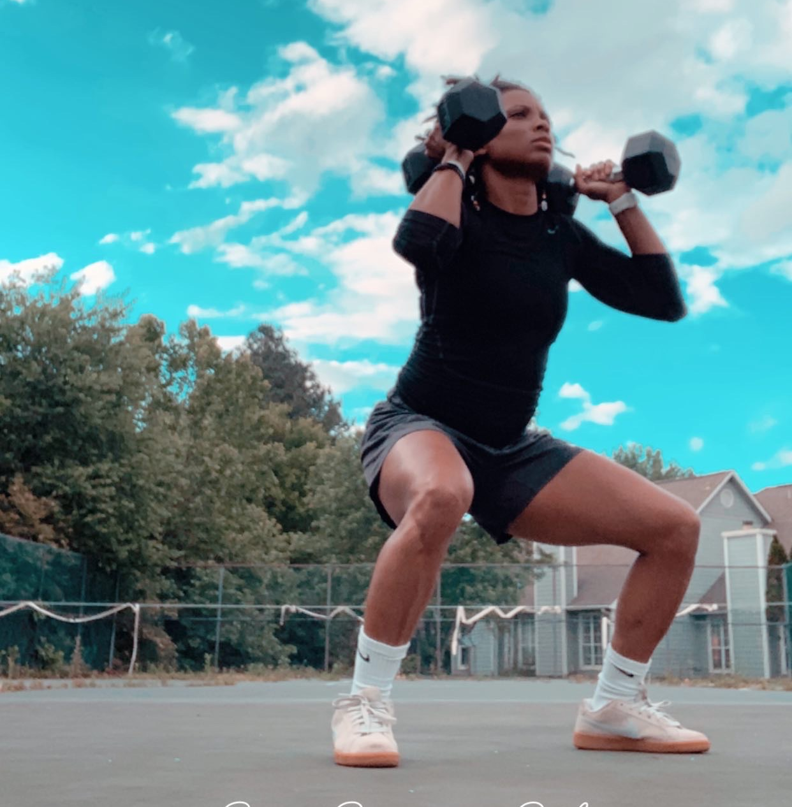
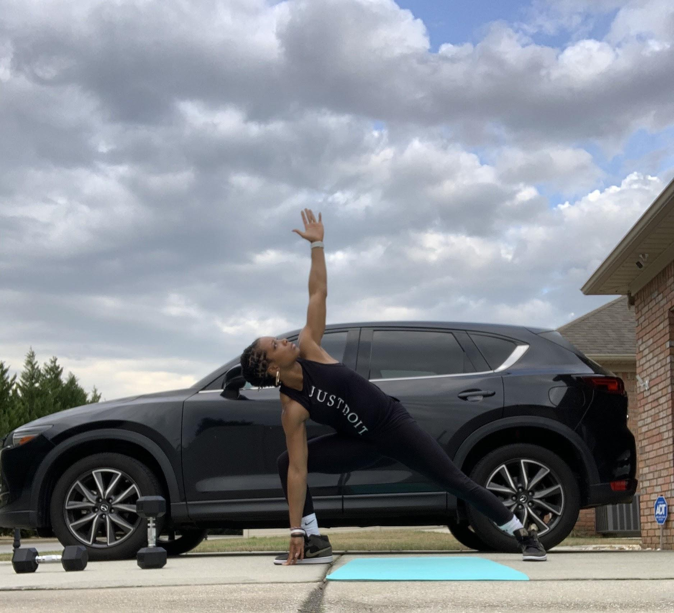
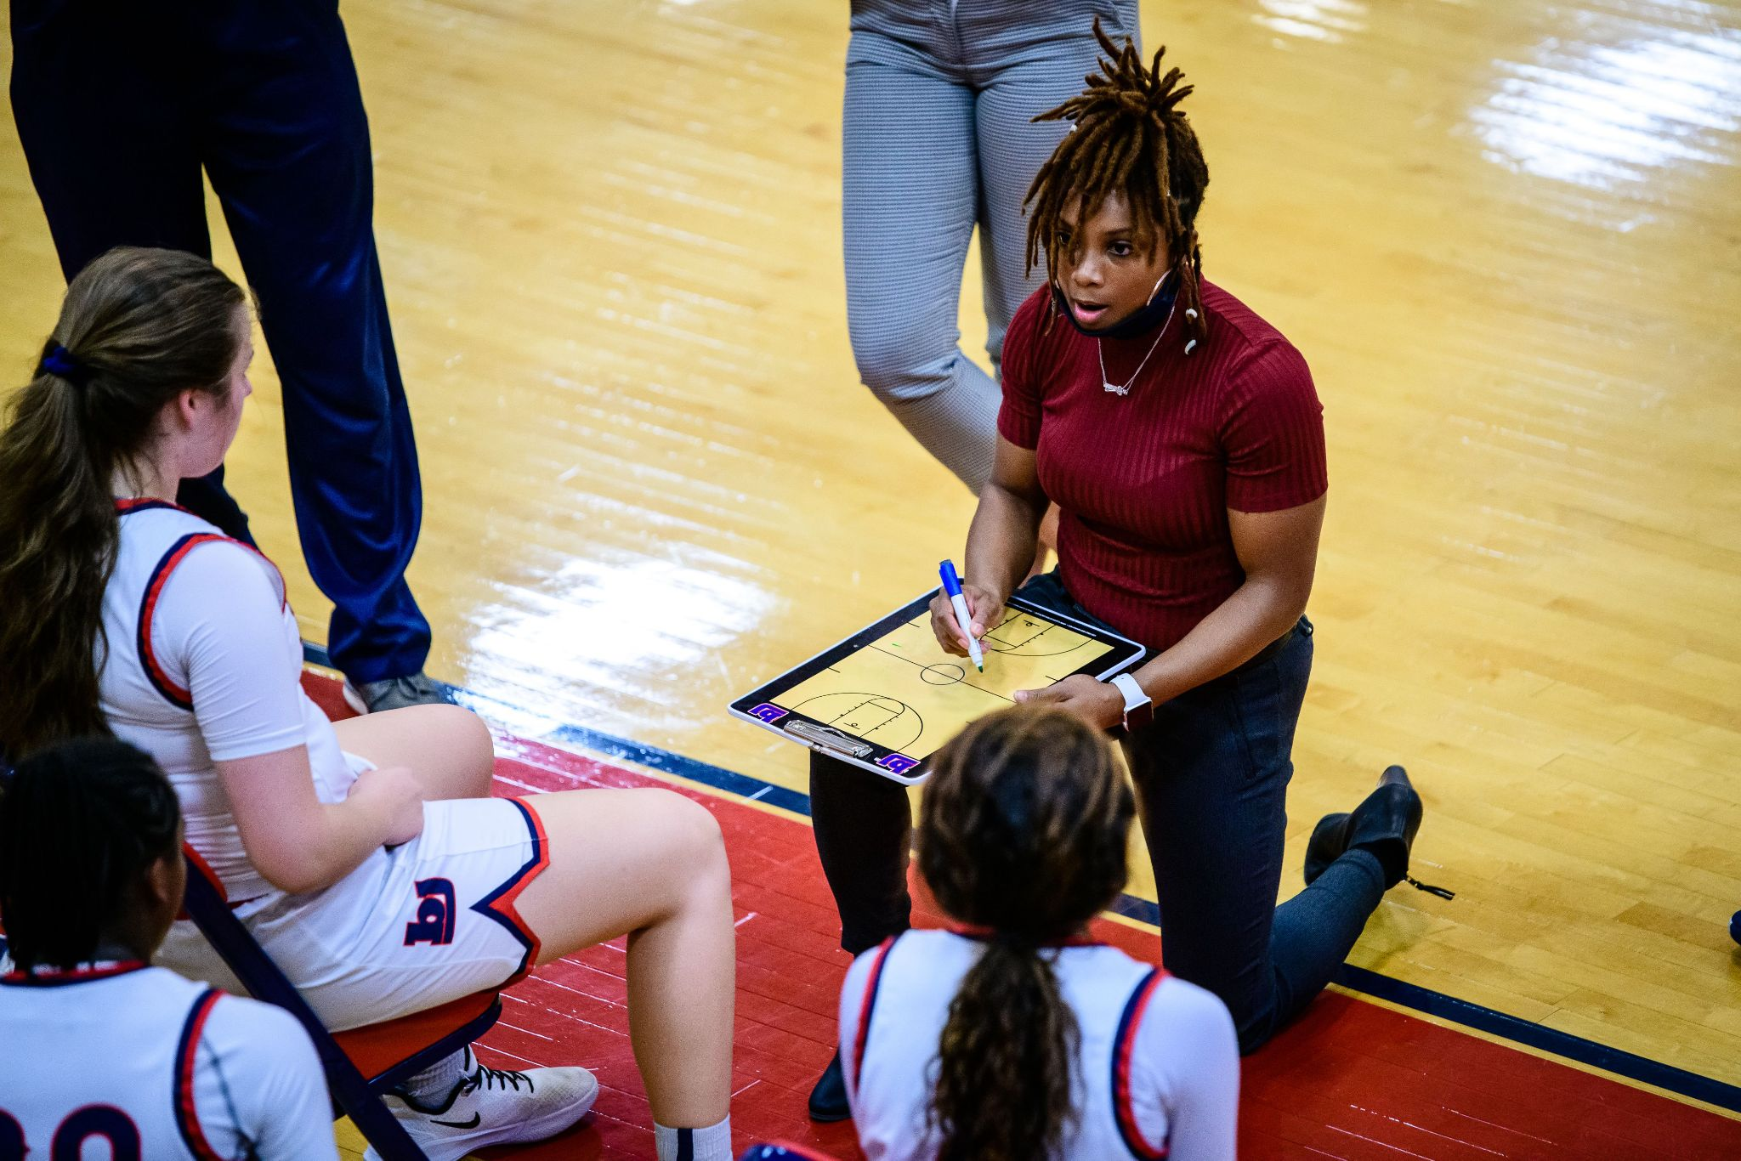
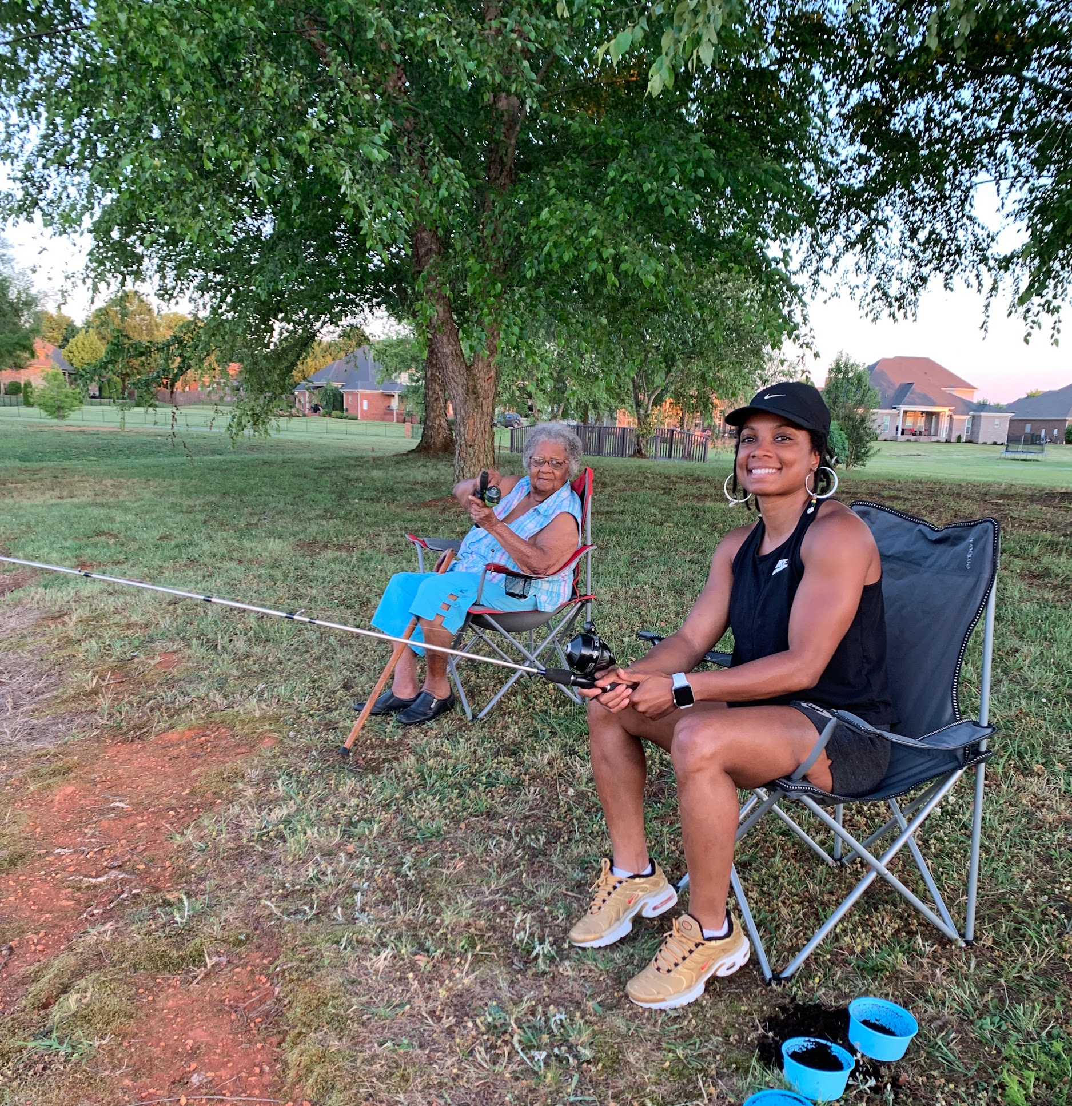
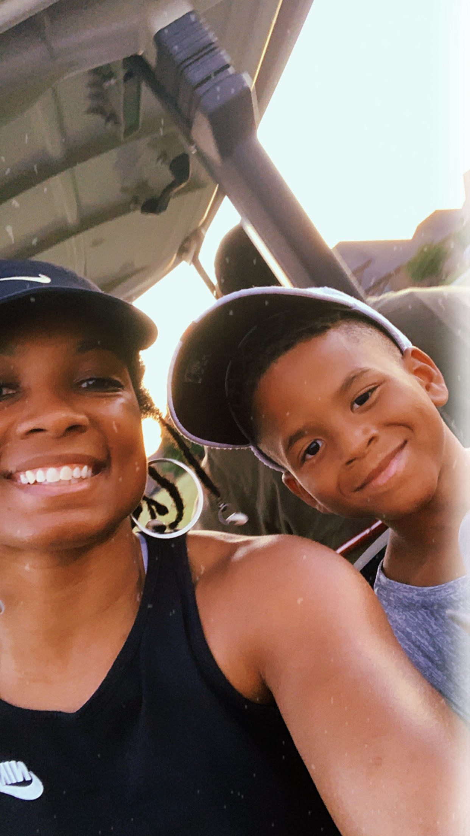
Favorites
Everything Fitness
Photography
Family
Coaching

Slide 4
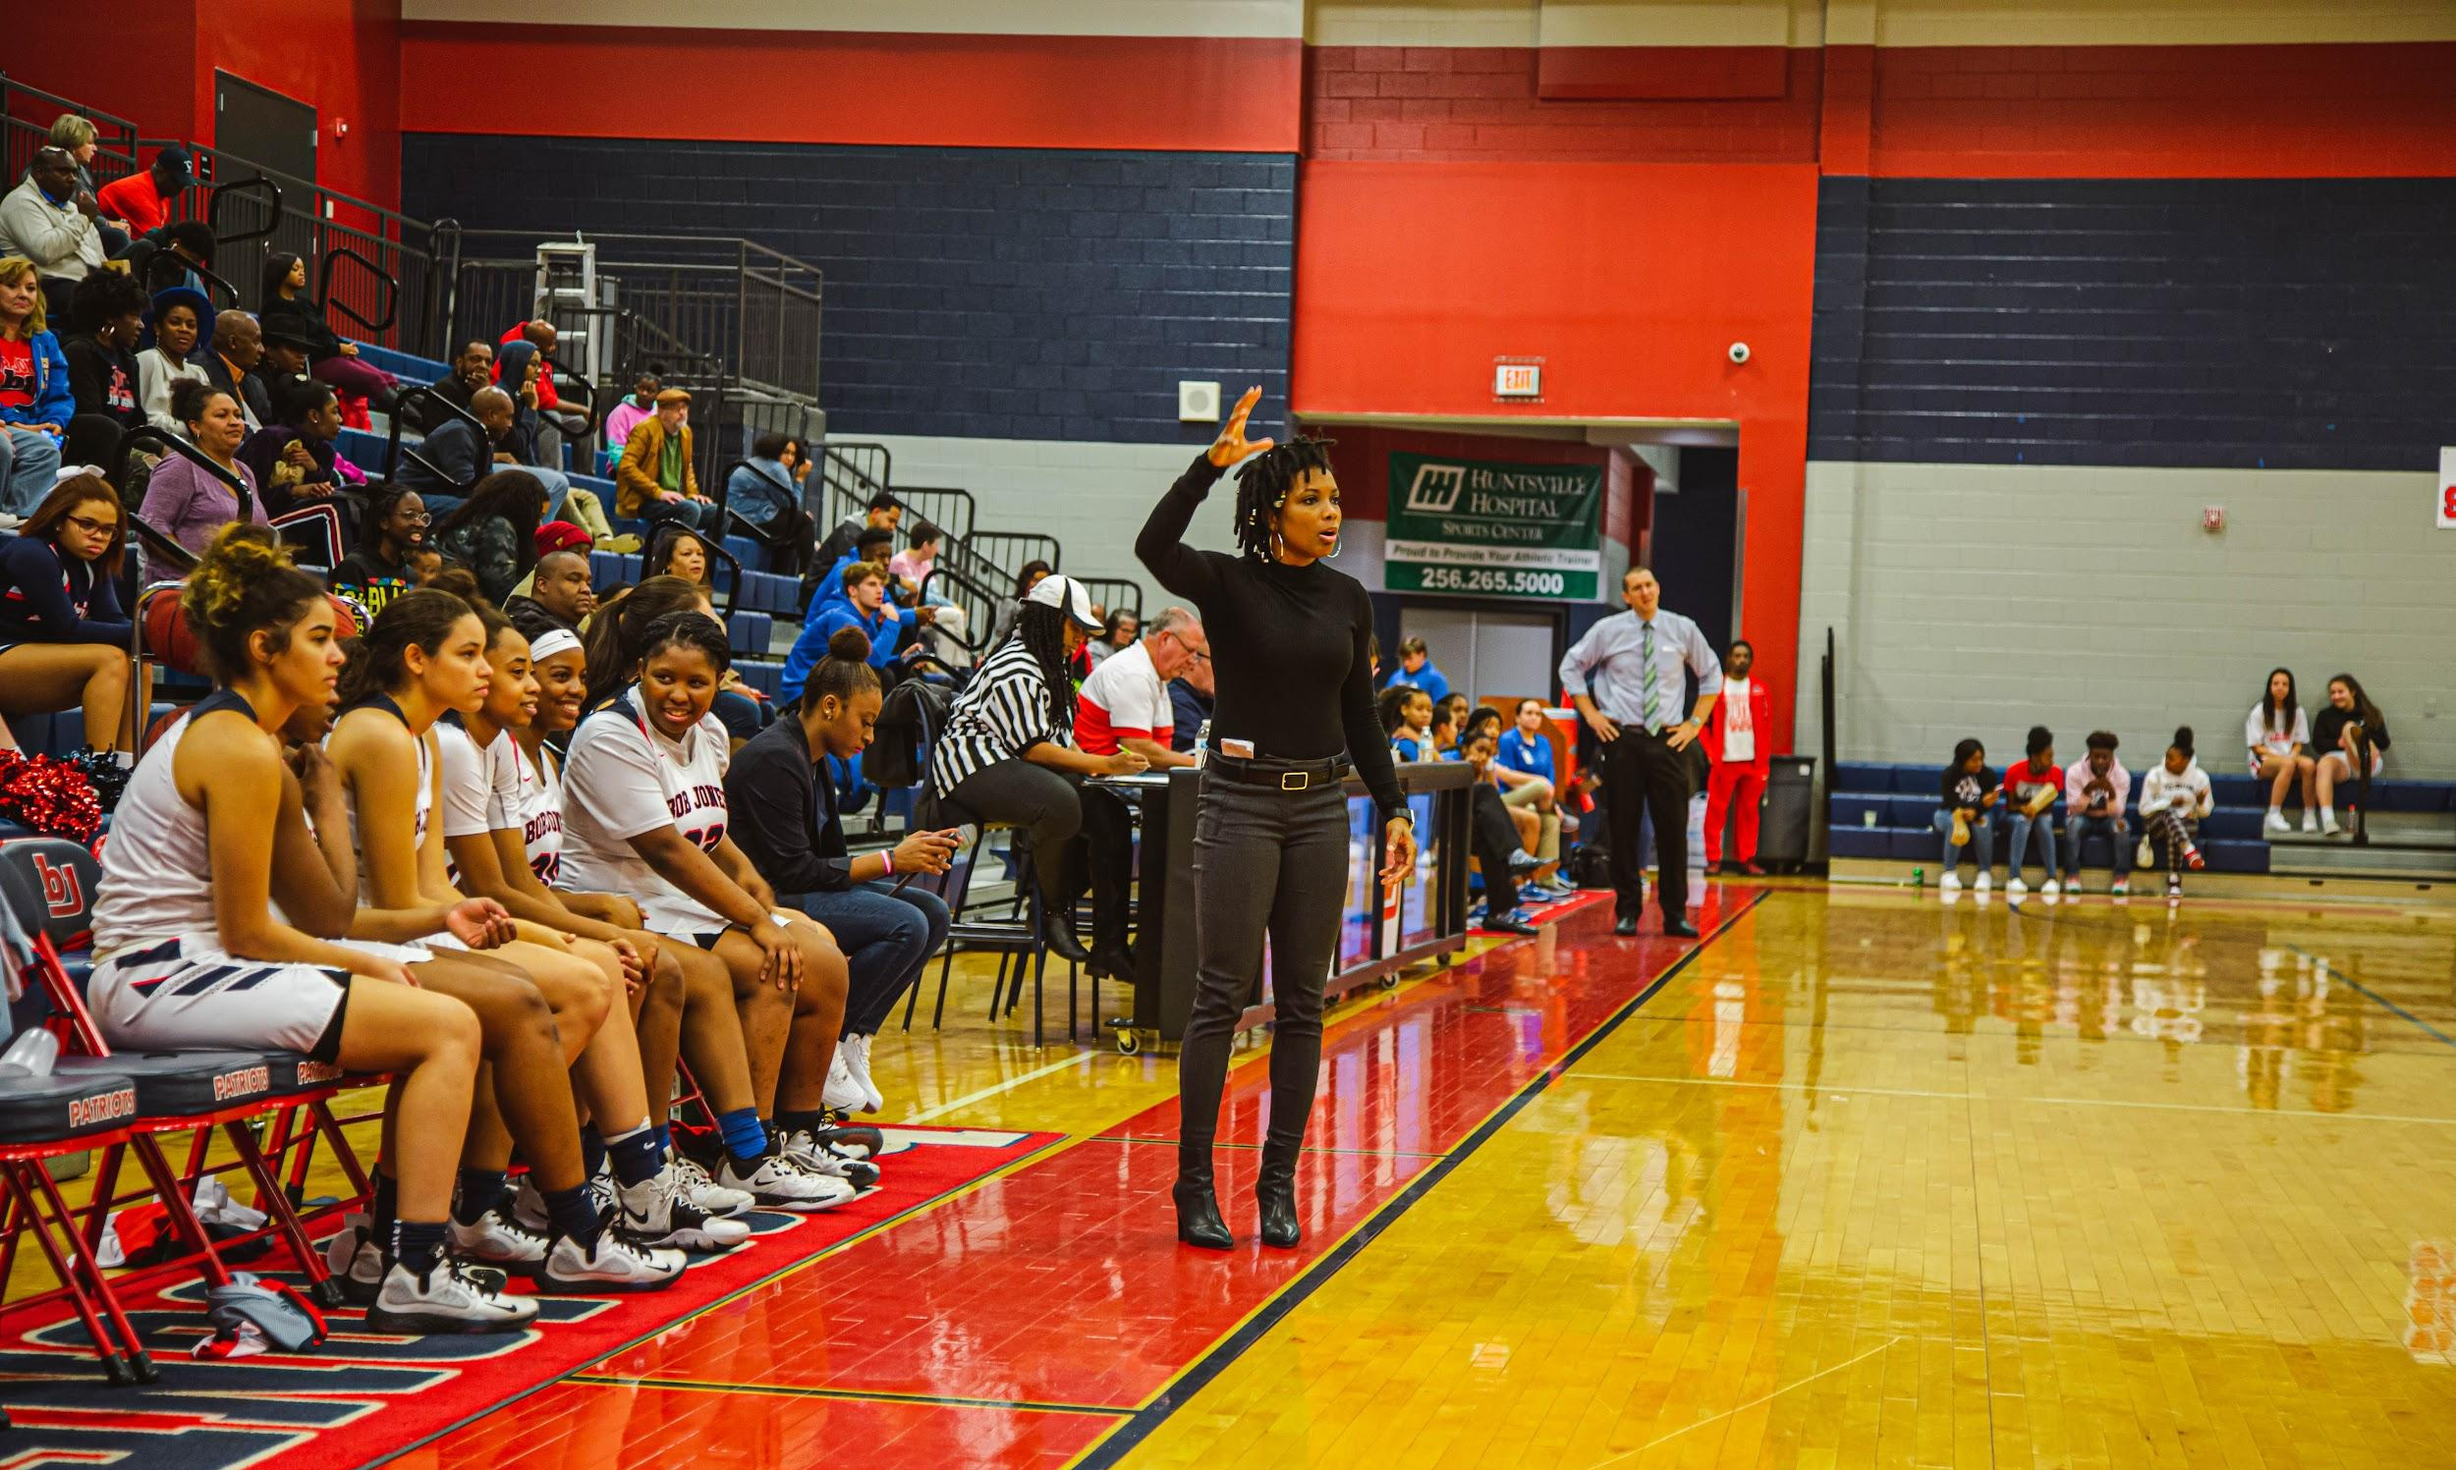
Experience
This will be my 3rd year teaching at Bob Jones High School but 6th year teaching overall. I will be teaching LIFE PE and Health. I'm super passionate about coaching, photography, fitness, and overall health. I attended Samford University and played on the women's basketball team for four years. I'm currently the Head Girls Basketball Coach here at Bob Jones. I love the platform I have as a high school educator because it allows me to make a difference in the lives of our students. I'm looking forward to another great year of teaching and coaching here at Bob Jones!
All assignments and materials will be posted on Schoology. All grades will be communicated in iNow.

Slide 5
Contact Information
Email | jpowers@madisoncity.k12.al.us
Website | https://www.madisoncity.k12.al.us/Domain/1901
 | @jazpow89
 | @bjladypats

